Slide 1
L’REZ Mobile App
FYP-Interim
Muhammad Aidiel-141665Z
Charlene Neo-xxxxxx

Slide 2

What we did
Mobile app for Lrez
Login
Home
Menu
Reservation
Information

Slide 3
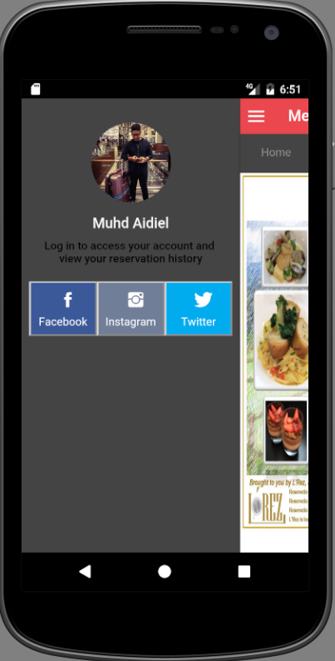
Login
Access tokens/Cordova Oauth plugin
Facebook
Instagram

Slide 4
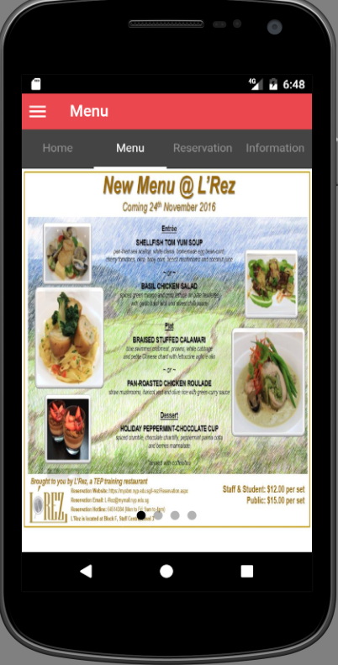
Menu
Display menu created by Lrez
Using carousel/slider

Slide 5
Reservation

Slide 6
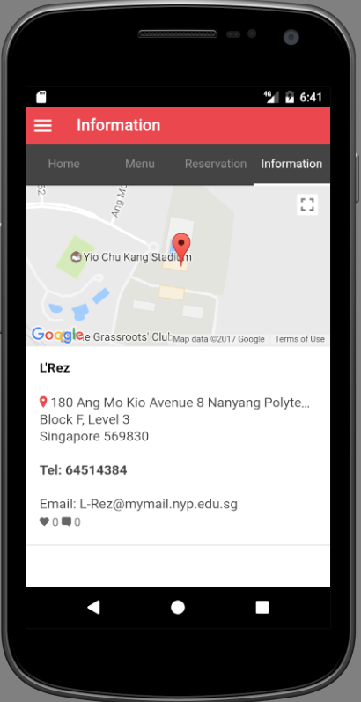
Information
Location of Lrez Restaurant(google-map)
Address
Contacts

Slide 7




Technology Used
Sublime- JavaScript, Angular JS, HTML5
Visual Studios
SQL Server 2014
Nodejs.cmd
Android Emulator

Slide 8
Challenges Faced
Aidiel
Unfamiliar with ionic
A lot of errors face in developing social media logins
Configuration and publishing of webpage
Errors extracting data from web/$http service
Emulator VS web serve
Charlene

Slide 9
DEMO

Slide 10
Q&A

Slide 11
THANK YOU!!!

